Slide 1
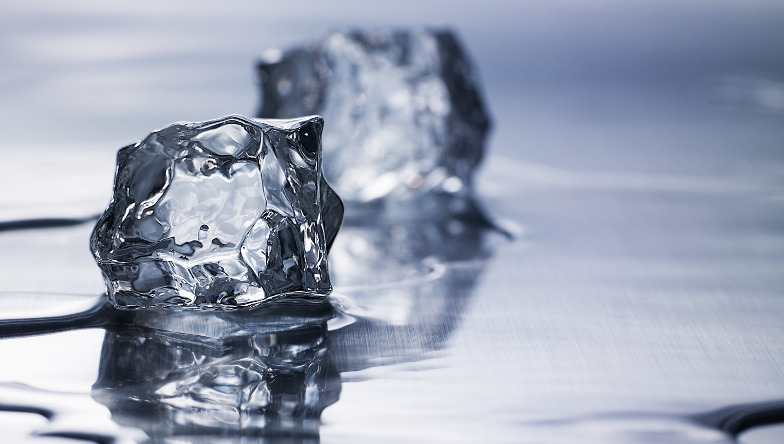
STATES OF MATTER
We will learn about solids, liquids, and gases, and some of their properties
Notes:
Insert cover image and use transparency settings to fade image.

Slide 2
Do not delete this slide.
This slide is designed so that you can copy the prompt box you need and insert it into your slides.
This slide is hidden and will not be included when presenting your lesson.
VOCABULARY
1 -
HINT
Students, remember….
CHECK FOR UNDERSTANDING
TEACHER CUE
MAKE THE CONNECTION
Students, you already know….
EXTENSION
TRACK WITH ME
READ WITH ME

Slide 3
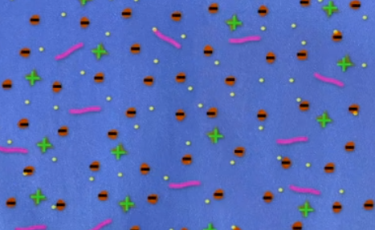
State what happens at each stage of water treatment:
Coagulation
Flocculation
Chlorination

Slide 4
Repeat the opposite word/phrase.
INDEPENDENT VARIABLE
WHAT WE CHANGE

Slide 5
Repeat the opposite word/phrase.
DEPENDENT VARIABLE
WHAT WE MEASURE

Slide 6
Repeat the opposite word/phrase.
CONTROL VARIABLE
WHAT STAYS THE SAME

Slide 7
We will learn about the different states of matter₁
TRACK WITH ME
READ WITH ME
VOCABULARY
1 – anything that physically exists; occupies space and has weight
We will define solids, liquids, and gases
We will list the ways that matter₁ changes state
DECLARE THE OBJECTIVE
Read the learning objective to your partner.
Notes:
Learning Objectives contain concepts (nouns, big ideas), skills (verbs, measurable behaviours) and sometimes context (restricting or targeting conditions).
●Example: Students will be able to describe the concept of density and apply it to floating and sinking.
●
Success criteria are specific measurable outcomes that if met mean that the student has met the learning objective.
Examples:
•Students will be able to compare densities of substances using mass and volume.
•Students will be able to identify whether a solid or liquid will float or sink in a liquid based on their densities.

Slide 8
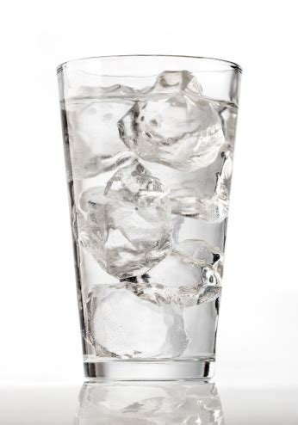
We will define solids, liquids, and gases
TRACK WITH ME
All matter₁ on Earth can be described as having a state; the 3 most common states of matter are solids, liquids, and gases.
Each state of matter has different properties₂ that make that state what it is
TEACHER CUE
Notice how the ice doesn’t match the shape of the cup; but the water does
VOCABULARY
1 – anything that physically exists 2 – a description of a thing

Slide 9
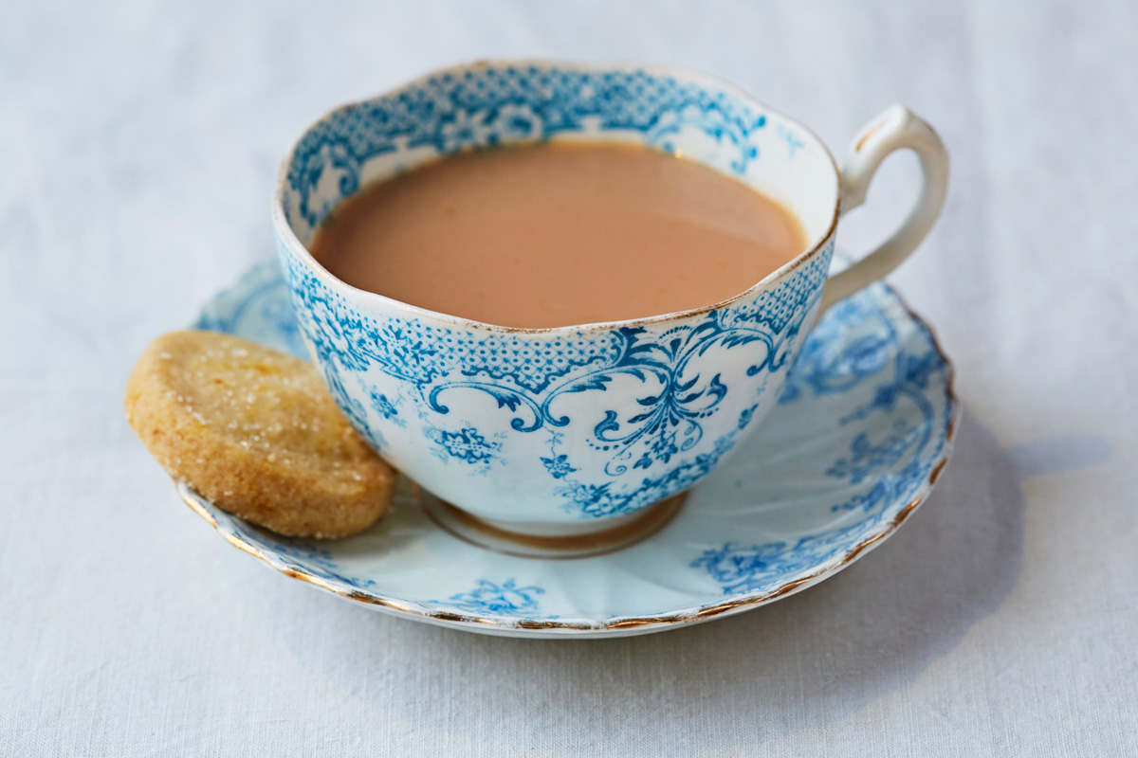
We will define solids, liquids, and gases
TRACK WITH ME
Solids are objects that hold their own shape and hard to compress₁ – even if you can change their shape, their volume doesn’t change.
Liquids are objects that have a shape that conforms to their container; they can freely move around. Liquids are also hard to compress₁.
Gases are objects that don’t have a shape, and fill whatever space they are in; they can also freely move around. Gases can be compressed₁.
HINT
A hot cup of tea is a good example of each state – the cup is a solid, the tea is a liquid, and the steam that comes from the tea is a gas
VOCABULARY
1 – To press together into a small space

Slide 10


We will define solids, liquids, and gases
3 minutes
For each of the following, list if they’re a solid, liquid, or a gas:
Air in a balloon
Coca-cola
Mr Beards
Lemon
Lemon juice
Washing detergent
EXTENSION
What are some other things you can find around your house that are a solid, liquid, or gas?

Slide 11
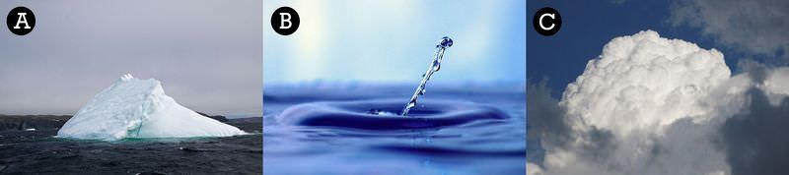
We will list the ways that matter changes state
TRACK WITH ME
EXTENSION
Is there a difference between water vapour and steam?
Water is special; it’s one of the few examples of matter that takes on all three states around the world:
Ice (A)
Water (B)
Water vapour (C)
MAKE THE CONNECTION
We’ve already seen water in all three forms – in the water cycle!

Slide 12
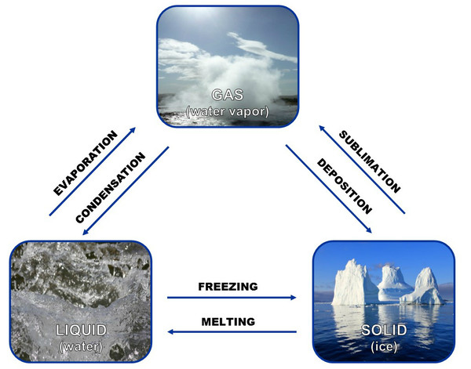
We will list the ways that matter changes state
TRACK WITH ME
We have different terms for when we move from each state to another:
MAKE THE CONNECTION
We’ve also seen these terms before – they also described processes in the water cycle!
HINT
If something evaporates because it is getting too hot, we also call it boiling
TEACHER CUE
Water is also very special in that it boils at 100ºC, and freezes at 0ºC

Slide 13

We will list the ways that matter changes state
CHECK FOR UNDERSTANDING
What states does the metal go through? What is each stage called?

Slide 14
5 minutes
We will list the ways that matter changes state
For each of the following changes, list what the process is called
Water turning into steam
Chocolate turning into melted chocolate
Milk that you make into ice-cream
Water droplets on the outside of a cold can of drink
Milk that you turn into chocolate milk
CHECK FOR UNDERSTANDING
How many did you get right?

Slide 15
We will list the ways that matter changes state
For each of the following, identify what state we are moving from and what state we are moving to, and what the process is called:
Making metal spoons
Instant heat packs
Ironing clothes
HINT
Think about how The King of Random made his metal poke-balls
EXTENSION
What processes happen around your house where objects change from one state to another?

Slide 16
We will learn about the different states of matter
TRACK WITH ME
READ WITH ME
We will define solids, liquids, and gases
We will list the ways that matter changes state
CHECK FOR UNDERSTANDING
Have you met the success criteria?
Notes:
Learning Objectives contain concepts (nouns, big ideas), skills (verbs, measurable behaviours) and sometimes context (restricting or targeting conditions).
●Example: Students will be able to describe the concept of density and apply it to floating and sinking.
●
Success criteria are specific measurable outcomes that if met mean that the student has met the learning objective.
Examples:
•Students will be able to compare densities of substances using mass and volume.
•Students will be able to identify whether a solid or liquid will float or sink in a liquid based on their densities.

